Slide 1

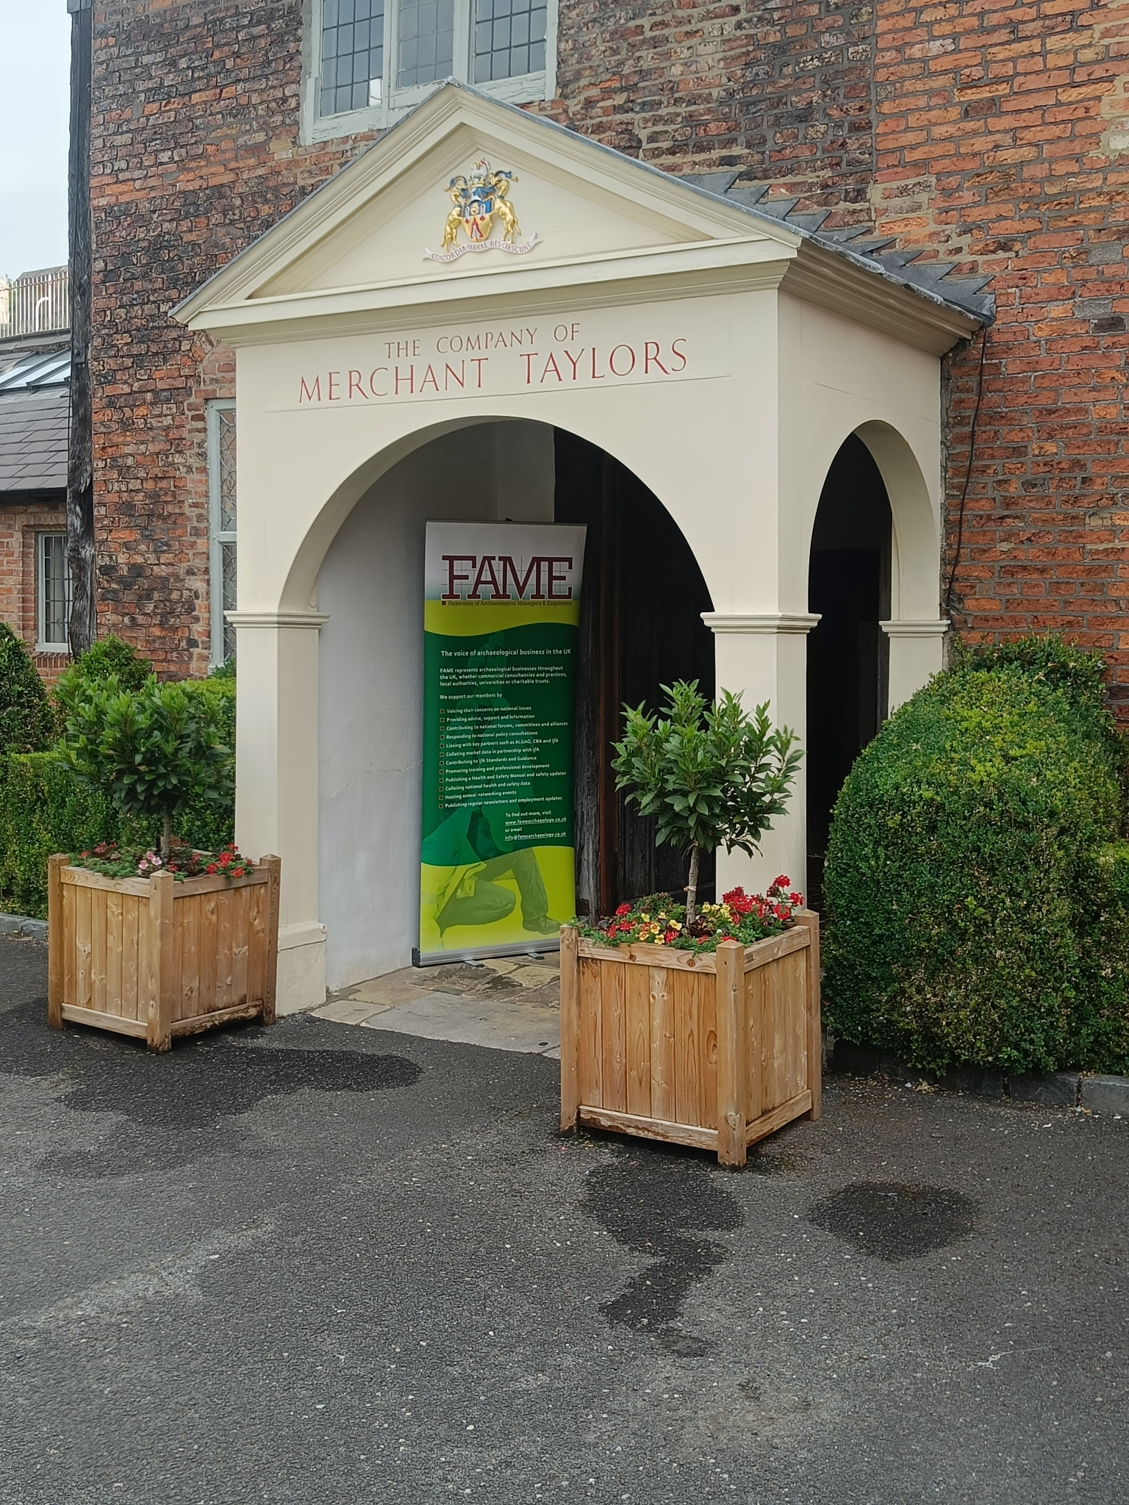
The Federation of Archaeological Managers & Employers - FAME

Slide 2

Potential conflict of interest

Slide 3
50 years of FAME
1972 – Regional ‘Units’ funded from central & local government
1975 – Standing Conference of Unit Managers - SCUM
1985 – insert ‘Archaeological’ - SCAUM

Slide 4
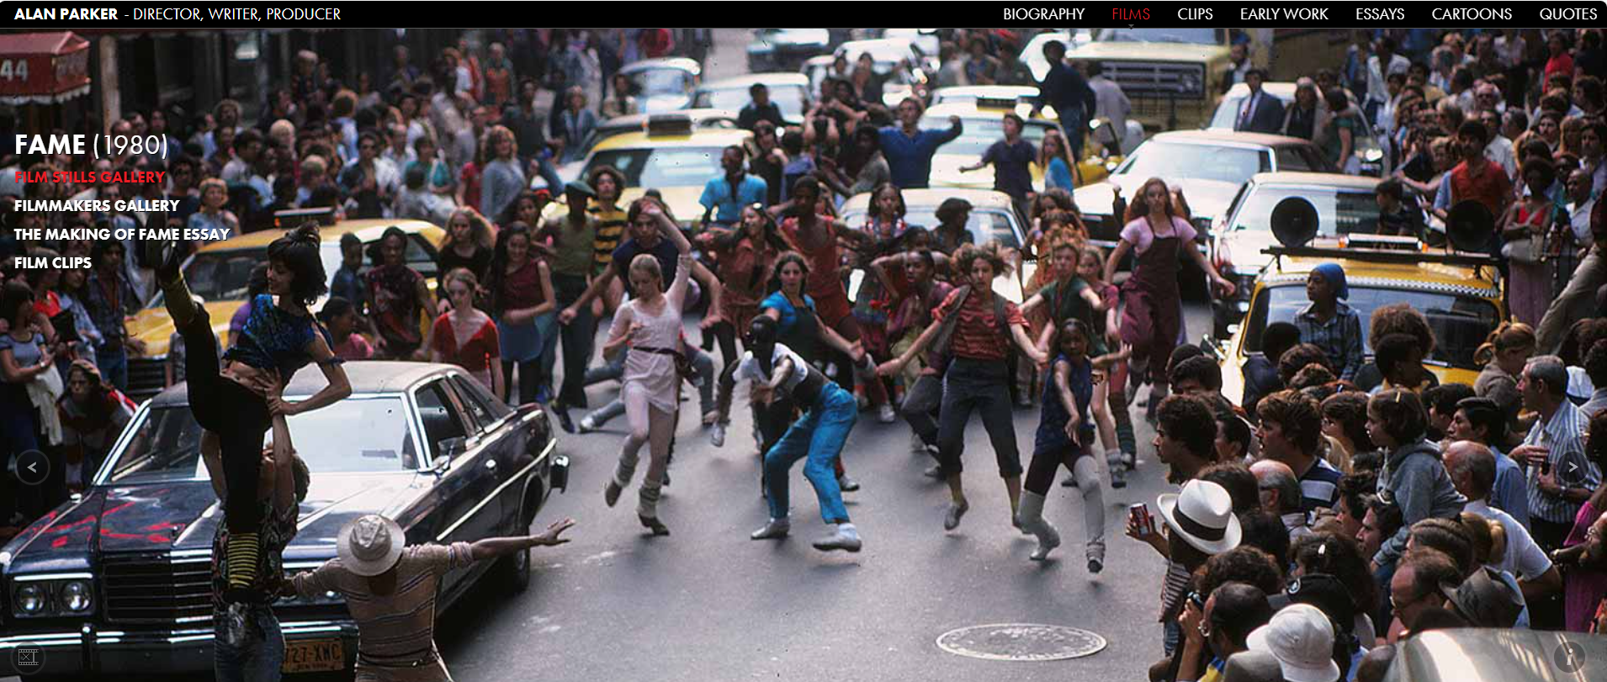
FAME in 1980

Slide 5
50 years of FAME
1972 – Regional ‘Units’ funded from central & local government
1975 – Standing Conference of Unit Managers - SCUM
1985 – insert ‘Archaeological’ - SCAUM
1986 – Health & Safety in Archaeological Fieldwork 1st edn

Slide 6
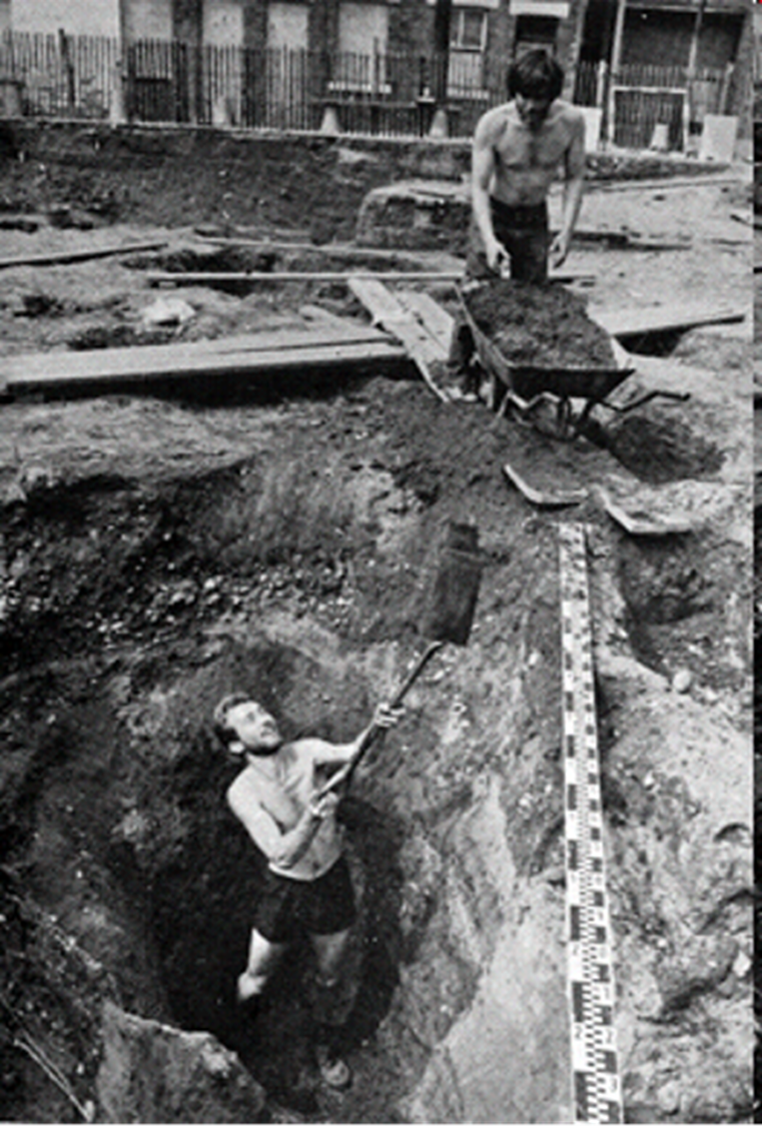
The Days Before Health and Safety
Buteaux 2006

Slide 7
50 years of FAME
1972 – Regional ‘Units’ funded from central & local government
1975 – Standing Conference of Unit Managers - SCUM
1985 – insert ‘Archaeological’ - SCAUM
1986 – Health & Safety in Archaeological Fieldwork 1st edn
1987 – Reading Business Park

Slide 8
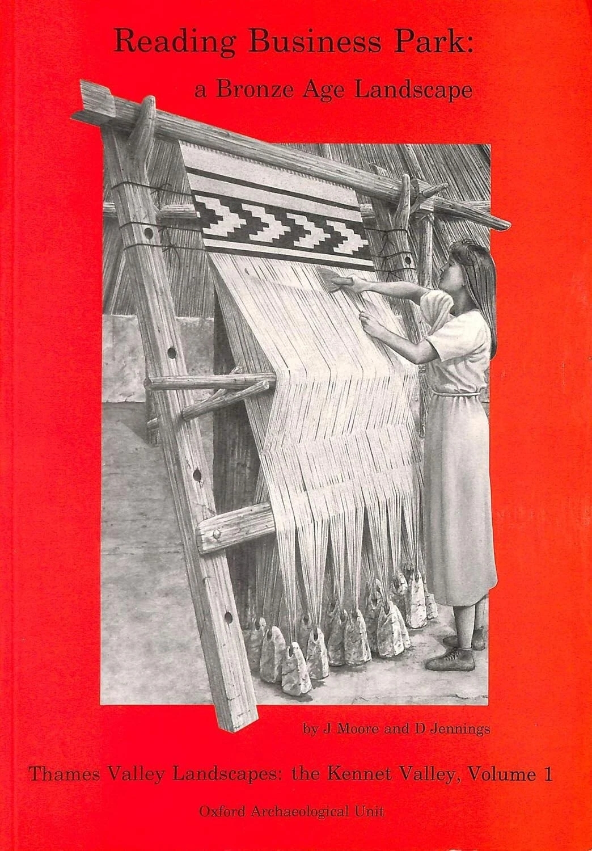
Reading Business Park
Oxford Archaeological Unit 1992

Slide 9
50 years of FAME
1972 – Regional ‘Units’ funded from central & local government
1975 – Standing Conference of Unit Managers - SCUM
1985 – insert ‘Archaeological’ - SCAUM
1986 – Health & Safety in Archaeological Fieldwork 1st edn
1987 – Reading Business Park
1990 – Planning Policy Guidance note 16: Archaeology & Planning

Slide 10
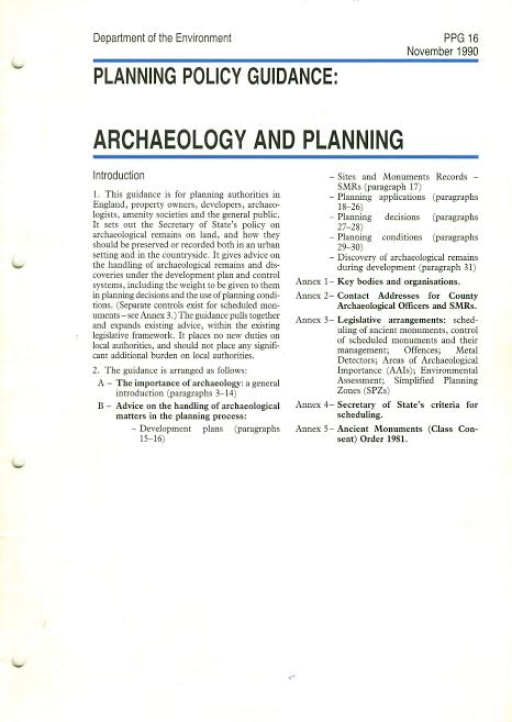
PPG 16
Department of the Environment 1990

Slide 11
50 years of FAME
1972 – Regional ‘Units’ funded from central & local government
1975 – Standing Conference of Unit Managers - SCUM
1985 – insert ‘Archaeological’ - SCAUM
1986 – Health & Safety in Archaeological Fieldwork 1st edn
1987 – Reading Business Park
1990 – Planning Policy Guidance note 16: Archaeology & Planning
1996 – Competitive Tendering in Archaeology guidance

Slide 12
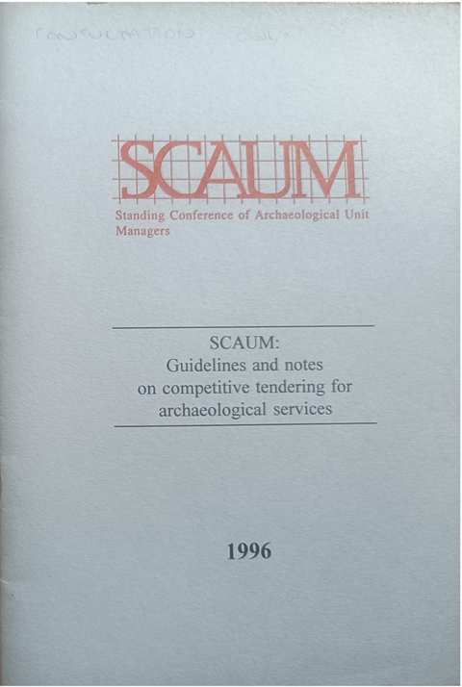
Competitive Tendering guidance
SCAUM 1996

Slide 13
50 years of FAME
2007 – Global economic crisis
2008 – Federation of Archaeological Managers & Employers – FAME
2010 – FAME has approx. 70 members
2020 – Brexit and COVID-19
2025 – 50 years since foundation of FAME

Slide 14
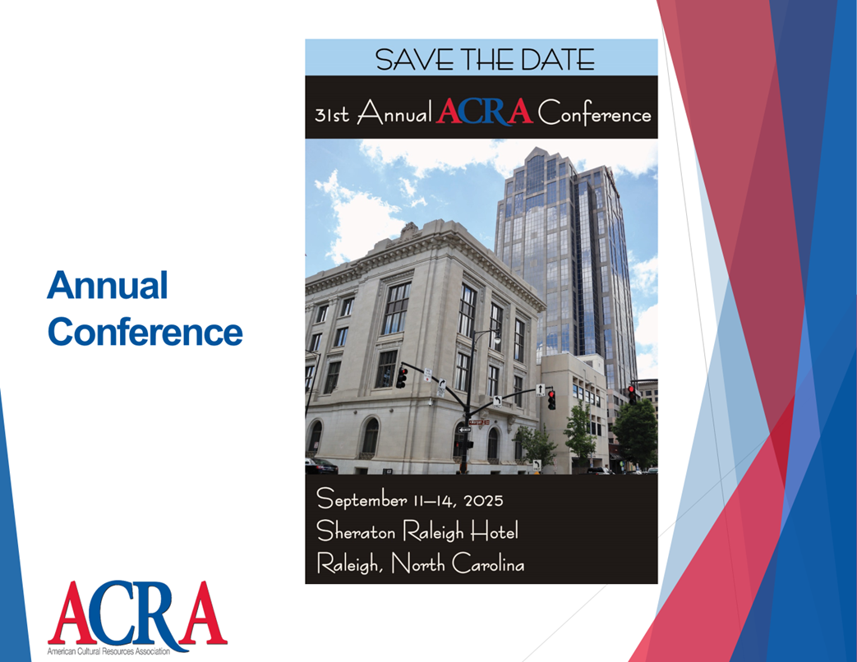
FAME in 2025
2025 – FAME welcomes ACRA CEO to annual FAME Forum
Notes:
UK archaeology – 6,766 FTE, 4,918 in commercial = 73%

Slide 15
50 years of FAME
2007 – Global economic crisis
2008 – Federation of Archaeological Managers & Employers – FAME
2010 – FAME has approx. 70 members
2020 – Brexit and COVID-19
2025 – 50 years since foundation of FAME
2025 – FAME publishes Carbon Calculator for Commercial Archaeology

Slide 16

FAME Carbon Calculator for Commercial Archaeology
https://famearchaeology.co.uk/what-we-do/environment-sustainability/

Slide 17
50 years of FAME
2007 – Global economic crisis
2008 – Federation of Archaeological Managers & Employers – FAME
2010 – FAME has approx. 70 members
2020 – Brexit and COVID-19
2025 – 50 years since foundation of FAME
2025 – FAME publishes Carbon Calculator for Commercial Archaeology
2025 – FAME publishes Principles for good practice in procurement

Slide 18
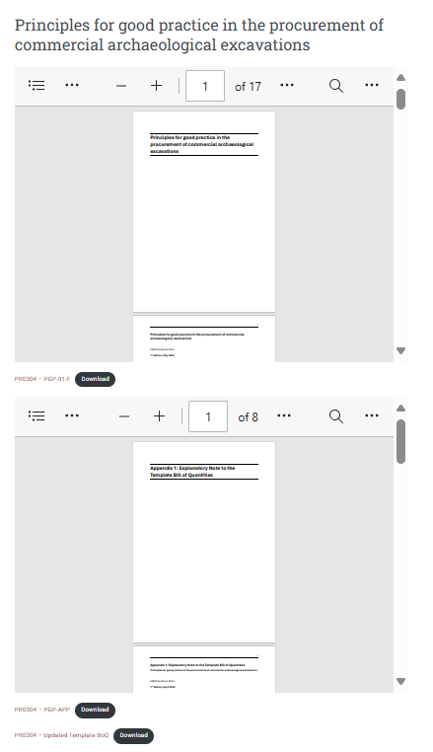
Principles for good practice in the procurement of commercial archaeological excavations
https://famearchaeology.co.uk/what-we-do/business-support/principles-for-good-practice-in-the-procurement-of-commercial-archaeological-excavations/

Slide 19
FAME in 2025
2025 – FAME has 73 members, of estimated 110 operators
3 companies are members of both FAME & ACRA
UK archaeology is a saturated market
UK sector’s annual revenue in 2024 is £337m (=$425m)
ten companies each have over 100 members of staff
everyone is having hiring difficulties
Notes:
UK archaeology – 6,766 FTE, 4,918 in commercial = 73%

Slide 20
WE CAN WORK TOGETHER!
Idea: Establish a working group.
Idea: Have annual Joint Webinars on relevant topics/issues.
Idea: Attendance at each other’s annual conference; panel discussion or presentation every other year.
Idea: Support each other on important issues.
Idea: Joint Conference in Toronto,Canada (1 -2 days)
Idea: ????

